Slide 1

Mastering DAGs
Notes:
https://courses.cs.washington.edu/courses/cse403/13au/lectures/git.ppt.pdf
http://enos.itcollege.ee/~jpoial/allalaadimised/git/getting-started-with-git.pdf

Slide 2
Start_date and schedule_interval parameters demystified
How they work

Slide 3
The most important parameters
start_date
The date from which tasks of your DAG can be scheduled and triggered.
schedule_interval
The interval of time from the min(start_date) at which your DAG should be triggered.
The DAG [X] starts being scheduled from the start_date and will be triggered after every schedule_interval

Slide 4
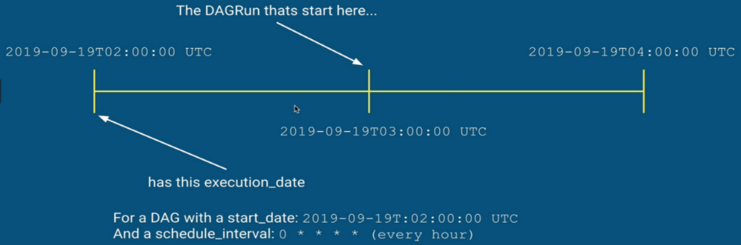
What is the execution_date

Slide 5
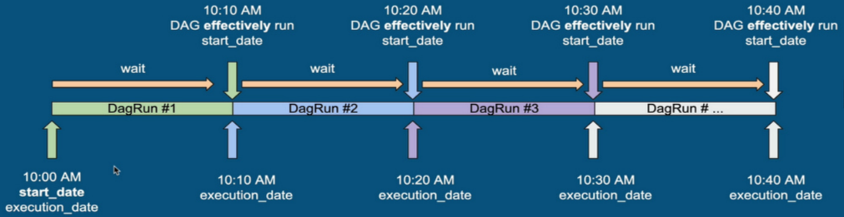
Execution flow

Slide 6
How to define the scheduling_interval
Either with
Cron expressions (ex: 0 * * * *)
Timedelta objects (ex: datetime . timedelta (days=l ))
As a best practice you should use cron expressions rather than timedelta objects as specified in the documentation.

Slide 7
What about end_date?
The date at which your DAG/Task should stop being scheduled
Set to None by default
Same recommendations than start_date

Slide 8
Backfill and Catchup
Kick off the missing DAG runs

Slide 9
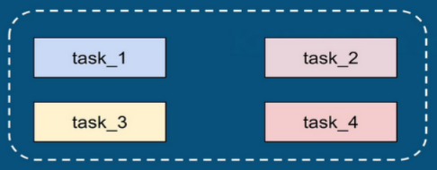
DagRun
The scheduler creates a DagRun object.
Describes an instance of a given DAG in time.
Contains tasks to execute.
Atomic, Idempotent

Slide 10
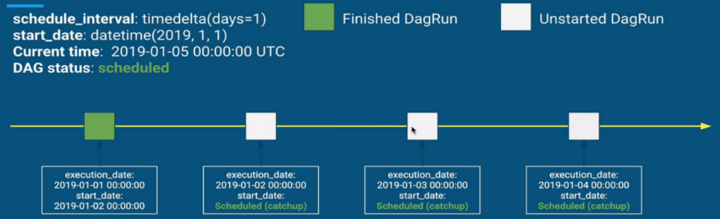
Catchup process
Notice the gap between the execution_date and start_date because of Catchup - Greater than schedule_interval

Slide 11
How to turn on/ off Catchup?
Either by
Setting the parameter catchup in the DAG definition to True or False
Changing the parameter catchup_by_de fault in airflow.cfg
By default, catchup_by_default=True

Slide 12
Dealing with timezones in Airflow
Make your DAGs timezone dependent

Slide 13
Definition
A timezone is a region of the globe that observes a uniform standard time.
Most of the timezones on land are offset from Coordinated Universal Time (UTC) by a whole number of hours (UTC-12:00 to UTC+7 4:00)
Example:
Paris: UTC+2:OO
New york: UTC-4:OO

Slide 14
Timezone in Python: Naive vs Aware
Python datetime.datetime objects with the tzinfo attribute set
Datetime aware
Python datetime.datetime objects without the tzinfo attribute set
Datetime naive
Why it matters?
Interpretation of naive datetime objects: BAD

Slide 15
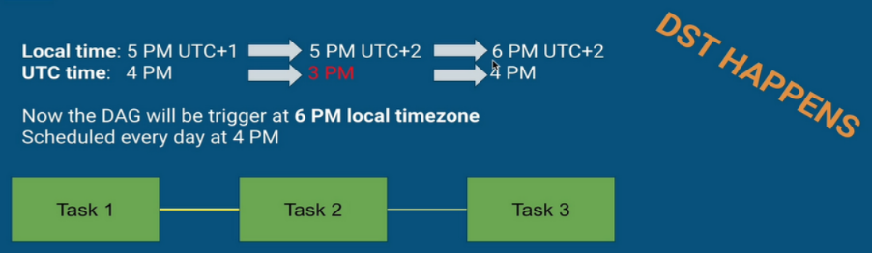
Example

Slide 16
Best Practices!
ALWAYS USE AWARE DATETIME OBJECTS
datetime.datetime() in python gives naive datetime objects by default!
A datetime without a timezone is not in UTC
Import airflow.timezone to create your aware datetime objects
Or let Airflow does the conversion for you

Slide 17
Timezones in Airflow
Airflow supports timezones
Datetime information stored in UTC
User interface always shows in datetime in UTC
Up to the developer to deal with the datetime
The timezone is set in airflow.cfg to UTC by default
default_timezone = utc
Airflow uses the pendulum python library to deal with time zones

Slide 18
How to make your DAG timezone aware?
Supply a timezone aware start_date using Pendulum:
import pendulum
local_tz = pendulum.timezone(“Europe/Amsterdam”)
default_args = { ‘start_date’: datetime(2019, 1, 1, tzinfo=local_tz), owner=’Airflow’ }
with DAG(‘my_dag', default_args=default_args):
…..

Slide 19
Cron schedules
Airflow assumes you will always want to run at the exact same time.
It will ignore the DST (Daylight Saving Time).
For example:
schedule_interval=0 5 * * *
will always trigger your DAG at 5 PM GMT + 1 every day regardless if DST is in place.

Slide 20
Timedeltas
When the schedule_interval is set with a time delta, Airflow assumes you always will want to run with the specified interval.
Example:
timedelta (hours=2)
will always trigger your DAG 2 hours later.

Slide 21
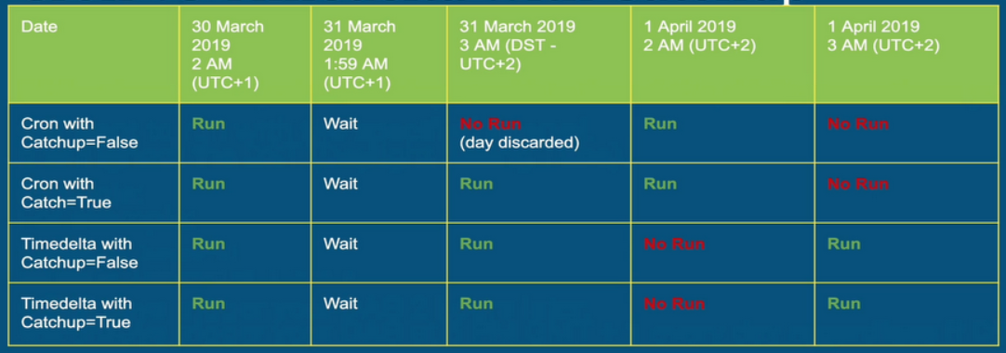
Cron vs Timedelta with Catchup
Important: For cron expressions, when DST happens 2 AM => 3 AM, the scheduler thinks the DAGRun of the 31 of March has been skipped and since Catchup=False, it won't get executed. The next DAGRun will be the lst of April at 2 AM.

Slide 22
How to make your tasks dependent
depends_on_past and wait_for_downstream

Slide 23
depends_on_past
Defined at task level
If previous task instance failed, the current task is not executed
Consequently, the current task has no status
First task instance with start_date allowed to run

Slide 24
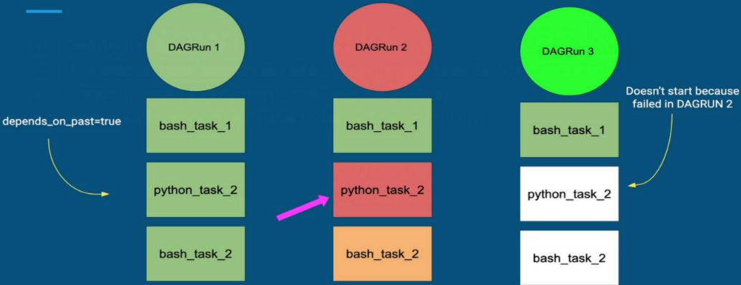
depends_on_past

Slide 25
wait_for_downstream
Defined at task level
An instance of task X will wait for tasks downstream of the previous instance of task X to finish successfully before it runs.

Slide 26
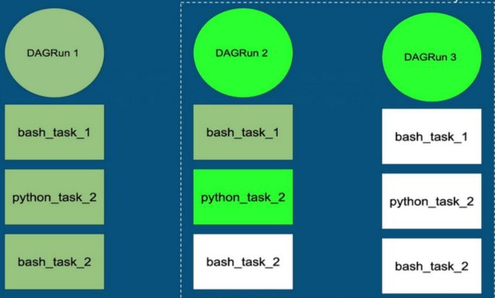
wait_for_downstream
Runs concurrently
waiLfor_downstream=true
Doesn't start because downstream tasks are not finished in DAGRUN 2

Slide 27
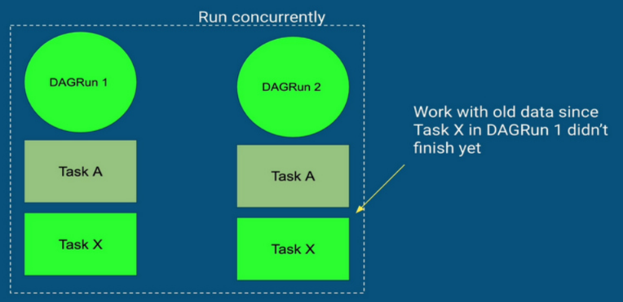
wait_for_downstream

Slide 28
How to structure your DAG folder
Managing your files and DAGs

Slide 29
DAG Folder
Folder where your Airflow dags are
Defined with the parameter dags_folder
The path must be absolute
By default: $AIRFLOW_HOME/ dags
Problem: too many DAGs, DAGs using many external files, ….
How can we structure the DAG folder?

Slide 30
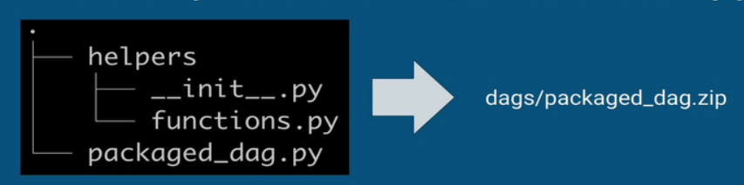
First way: Zip
Create a zip file packing your DAGs and its unpacked extra files
The DAGs must be in the root of the zip file
Airflow will scan and load the zip file for DAGs
If module dependencies needed, use virtualenv and pip

Slide 31
Second way: DagBag
A DagBag is a collection of DAGs, parsed out of a folder tree and has a high-level configuration settings.
Make easier to run distinct environments (dev/staging/prod)
One system can run multiple independent settings set
Allow to add new DAG folders by creating a script in the default DAGs folder
Warning: If a DAG is loaded with a new DagBag and is broken
Errors are not displayed from the UI
Can’t use the command "airflow Iist_dags" (only work)
Still able to see the errors from the web server logs

Slide 32
.airflowignore
Specifies the directories or files in the DAGs folder that Airflow should ignore.
Equivalent to the .gitignore file.
Each line corresponds to a regular expression pattern.
The scope of a .airflowignore is the current directory as well as its subfolders.
Airflow looks for “DAG" or “airflow” in files. You can avoid wasting scans by using the .airflowignore file.
As best practice, always put a .airflowignore file in your DAGs folder.

Slide 33
How to deal with failures in your DAGs

Slide 34
Dag failure detections
Detection on DAGs
DAG level
dagrun_timeout
sla_miss_callback
on_failure_callback
on_success_callback

Slide 35
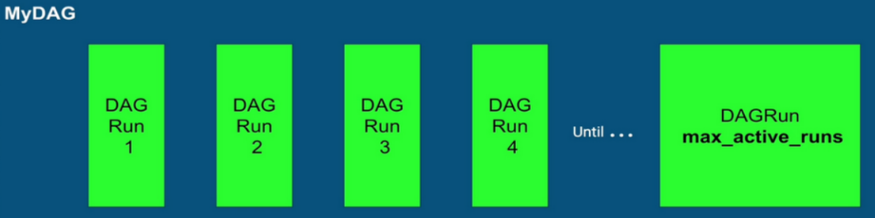
max_active_runs
If max_active_runs isn’t set, Airflow use max_active_runs_per_dag in airflow.cfg

Slide 36
Dag failure detections
Detection on DAGs
DAG level
dagrun_timeout
sla_miss_callback
on_failure_callback
on_success_callback

Slide 37
Task failures detection
Detection on Tasks
Task level
email
email_on_failure
email_on_retry
retries
retry_delay
retry_exponential_backoff
max_retry_delay
execution_timeout
on_failure_callback
on_success_callback
on_retrv_callback

Slide 38
How to test your DAGs
Unit testing

Slide 39
Unit testing with Pytest
Pytest
Allow for compact test suites
Easier to understand (minimal boilerplate)
Pretty and useful failure information
Widely used
Nice documentation
Easy to use
Extensible
Check their website: https://docs.pytest.org/en/latest

Slide 40
How to test a DAG?
Five categories:
DAG Validation Tests
DAG/Pipeline Definition Tests
Unit Tests
Integration Tests
End to End Pipeline Tests

Slide 41
DAG Validation Tests
Common tests for all DAGs in Airflow
Check if valid
Check if there is no cycles
Check default arguments
High level of testing of DAGs

Slide 42
DAG/ Pipeline Definition Tests
Test if modifications are intentional
Check total number of tasks
Check the nature of tasks
Check the upstream and downstream dependencies of tasks

Slide 43
Unit Tests
Unit testing external functions or custom Operators
Check the logic
Unit Tests

Slide 44
Integration Tests
Tests if tasks work well with each others using a subset of production data
Check if tasks can exchange data
Check the input of tasks
Check dependencies between multiple tasks
Need development/test/acceptance/production environments

Slide 45
End to End Pipeline Tests
Test the data pipeline
Check if the output is correct
Check the full logic
Check performances
Need development/test/acceptance/production environments

Slide 46
Create different environments
Development
Faked small data input
Verify:
DAG Validation Tests
DAG/Pipeline Test
Unit Tests
Test
Larger amount of real data
Verify:
Integration Tests
Acceptance
Copy production datasets
Verify:
End to End Pipeline Tests
Production
All production data
Used by the end users

Slide 47
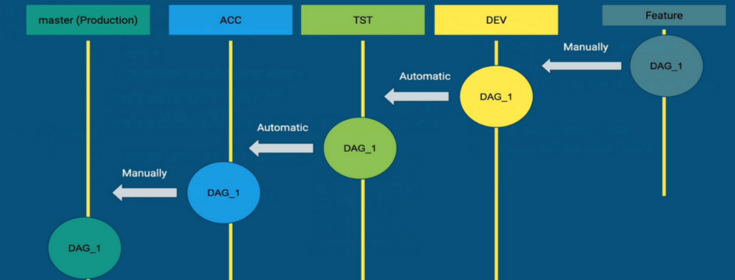
Git Repository and Branches

Slide 48
Command Line Interfaces
Some useful commands:
airflow run
Run a single task instance
airflow list_dags
List all the DAGs
airflow dag_state
Get the status of a DAG run
airflow task_state
Get the status of a Task instance
airflow test
Test a task instance without checking for dependencies or recording its state in the db

Slide 49
Thanks

